Slide 1
Spam Message Detection Using NLP In a Real-Time Chat Application
Submitted by :​
Ujjwal Aryal
Subash Pandey
Srijan Tangnami Magar

Slide 2
Spam Detection System
Spam Detection System is an practical application of NLP with ML framework which can detect any messages as spam or ham.
It can be integrated in many of the applications like chat application, email service.
We have primarily built a model which can detect any spam messages and integrated in a chat application that alerts when any spam message is detected.

Slide 3
Problem Statement
The menace of spam message is on the increase on yearly basis and is responsible for over 77% of the whole global message traffic.
Users who receive spams that they did not request, find it very irritating.
It results to untold financial loss to many users who have fallen victim of internet scams and other fraudulent practices.

Slide 4
Objectives
To classify messages as spam or ham as it is a major problem.
To integrate spam filter in a chat application.

Slide 5
Literature Review
S.N. | Title | Authors | Year Published | Description
1. | Spam mail detection using hybrid secure hash based naive classifier | S. Ajaz, M. Nafis, and V. Sharma | 2022 | Hybrid approach using secure hash method and Naive Bayes to filter email data.
2. | Machine learning based spam e-mail detection | P. Sharma and U. Bhardwaj | 2018 | Combines two methods that is Machine Learning and Knowledge Engineering for the filtering of emails
3. | Content based spam detection in email using Bayesian Classifier | S. B. Rathod and T. M. Pattewar | 2015 | Uses Bayesian Classifiers considering every single word in the mail constantly adapting to new forms of spam.
4. | Identification of spam email based on information from email header | S.bin Abd Razak and A. F. B. Mohamad | 2013 | Focuses on email header which will be used to identify and classify spam messages efficiently.

Slide 6
Functional Requirements
Detect spam messages
Efficient communication

Slide 7
Non Functional Requirements
Security
Reliability
PERFORMANCE

Slide 8
Feasibility Study
Economic Feasibility
Technical Feasibility
Operational Feasibility
Time Feasibility

Slide 9
Software Requirements
Natural Language Toolkit
Python
Jupyter Notebook
Seaborn
MS Teams
Star UML
Scikit Learn

Slide 10

Methodology

Slide 11
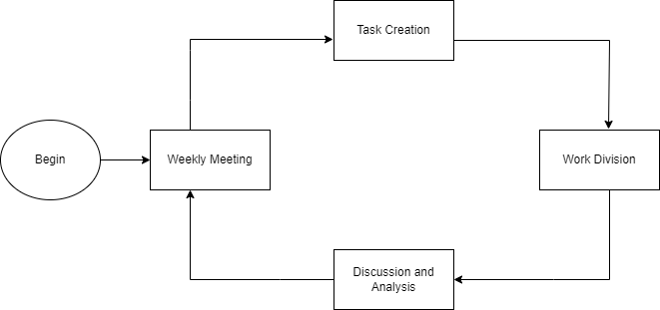
Software Development Approach
Figure: Agile Model

Slide 12

System Block

Slide 13
Data Cleaning
Data Preprocessing
Conversion to Lowercase
Tokenization
Removing Special Characters
Stop words Removal
Vectorization
Model Building
NB
LR
Evaluation and Deployment

Slide 14
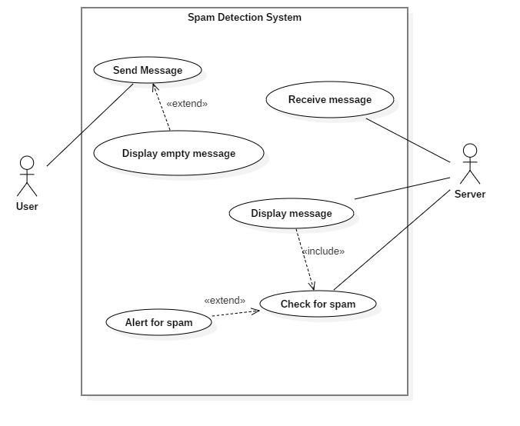
Use Case Diagram
Figure : Use Case Diagram

Slide 15
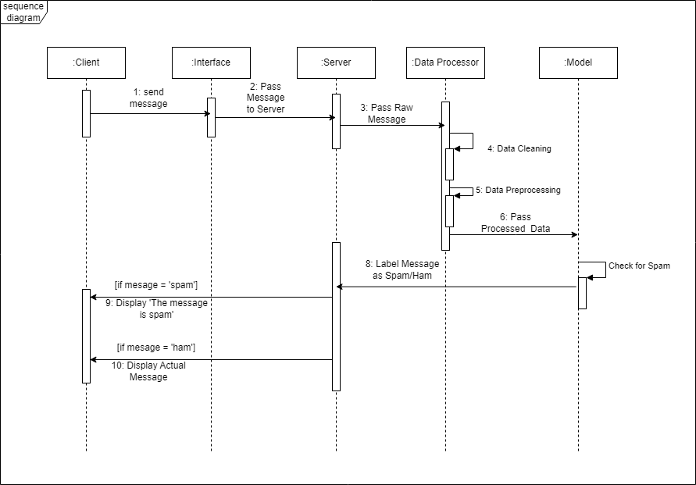
Sequence Diagram
Figure : Sequence Diagram

Slide 16
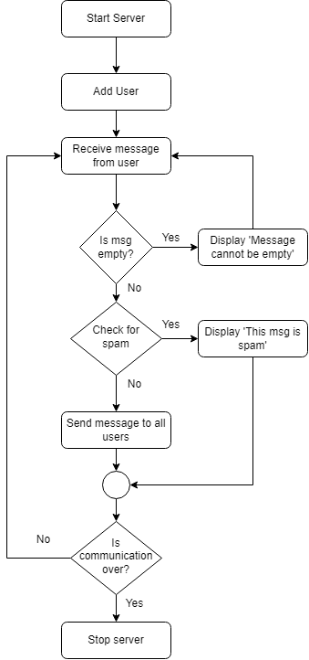
Flowchart
Figure: System Flow

Slide 17
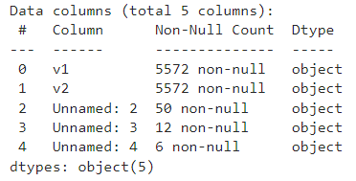
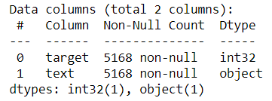
Data Cleaning
We can see in our data set that in the columns ’Unnamed:2’, ’Unnamed:3’ and ’Unnamed:3’ most of the values are null. There are several duplicate rows which we also need to get rid of. We also have to properly name the columns. The figure shown below consists of data info before and after cleaning.
Figure: Before Cleaning
Figure: After Cleaning

Slide 18
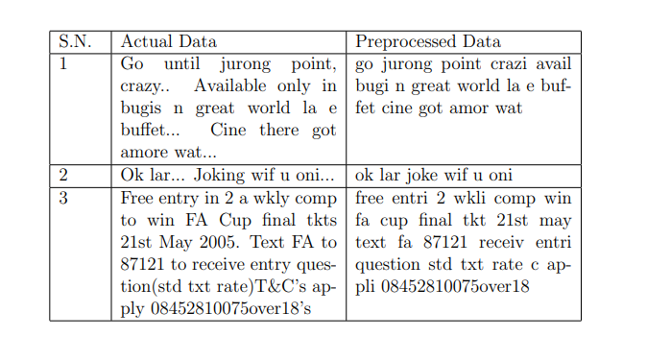
Data Pre-Processing
Data should be pre-processed before building the model. The step involved in data-preprocessing are as follows:
Conversion to lower case
Tokenization
Removing special characters
Removing stop words and punctuation
Stemming
Table : Sample of preprocessed data

Slide 19
Vectorization
We have used tf-idf vectorizer and Bag of Words Vectorization before training our models.

Slide 20
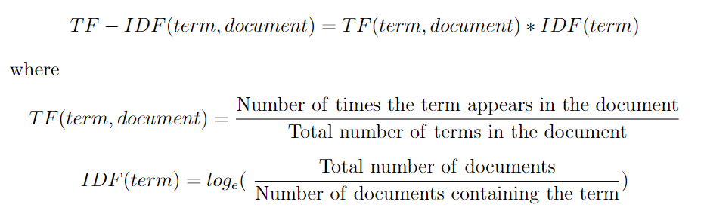
TF-IDF Vectorization
TF-IDF (Term Frequency-Inverse Document Frequency) is a technique used in information retrieval and text mining to quantify the importance of each term in a document.

Slide 21
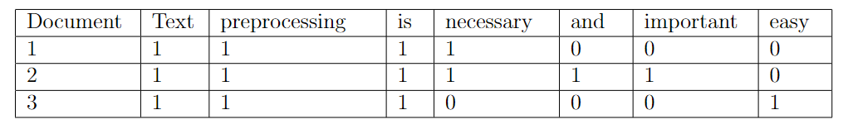
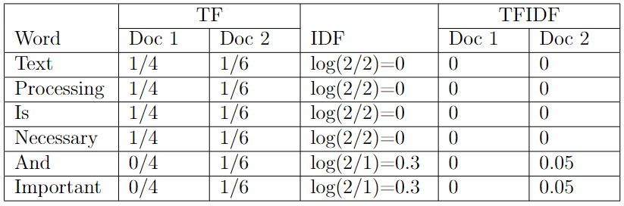
Example
Table : Word along with frequency in given document
Table : TFIDF Calculation

Slide 22
Bag of Words Vectorization
CountVectorizer is a tool used in natural language processing (NLP) to convert a collection of text documents into a matrix of token counts.
Table : Representation in Theory
Table : Representation in Practice

Slide 23
Modeling
We have used Naive Bayes and Logistic Regression Algorithm to train our model.

Slide 24
Logistic Regression(LR)
We have used Logistic Regression algorithm implemented in scikit-learn library and found following score with default parameters:
Metrics | Result
Accuracy | 0.9429
Precision | 0.9036
F1 Score | 0.5886
Recall | 0.7377
Table : LR Metrics with default parameters

Slide 25
We have then used GridSearchCV of Scikit-Learn library to find the optimal parameters of Logistic Regression Model.

Slide 26
Hyperparameter Tuning Using GridSearchCV
We have analyzed the combination of following parameters:
solvers = [’newton-cg’,’lbfgs’, ’liblinear’]
penalty = [’l2’]
c values = [100, 10, 1.0, 0.1, 0.01]

Slide 27
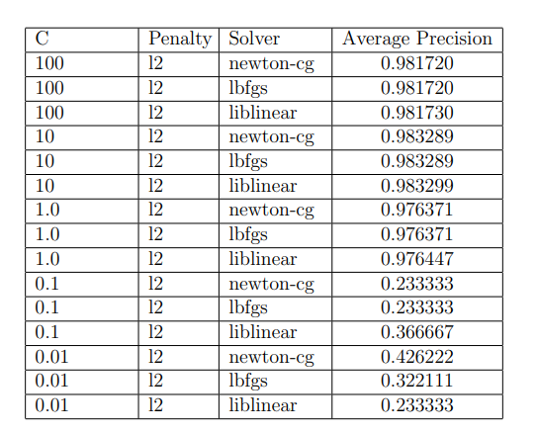
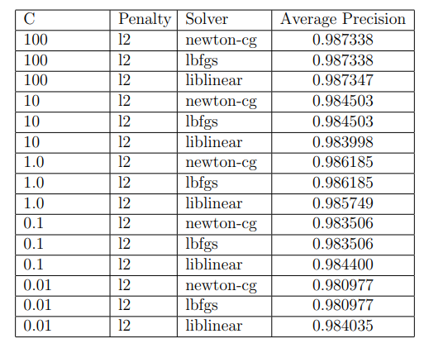
Table : GridSearchCV Result for tf-idf Vectorizer
Table : GridSearchCV Result for Bag of Words Vectorizer

Slide 28
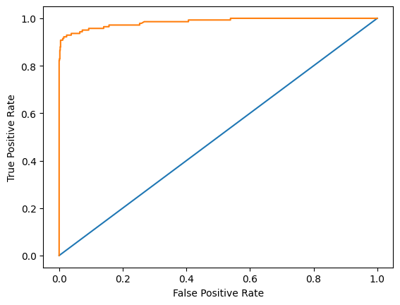
The result shows that the maximum score is 0.987347 using {C: 100, penalty: ’l2’, solver: ’liblinear} and Bag of Words vectorizer.
Metrics | Result
Accuracy | 0.9777
Precision | 0.9836
F1 Score | 0.8510
Recall | 0.9125
Figure : ROC Curve for LR Model Using Optimal Parameters
Table : LR Metrics with optimal parameters

Slide 29
Naive Bayes Classifier(NB)
We have tried all three types of Naive Bayes model under the scikit-learn library: Gaussian Naive Bayes (GNB), Multinomial Naive Bayes (MNB), Bernoulli Naive Bayes (BNB). Since Naïve Bayes works well with tf-idf vectorizer, we transformed our text using td-idf vectorizer before feeding it into the model. The metrics for every model under Naive Bayes was found as follows:
Models | Accuracy | Precision | F1 Score | Recall Score
GNB | 0.8771 | 0.5324 | 0.6442 | 0.5324
MNB | 0.9535 | 1.0 | 0.6595 | 0.7948
BNB | 0.9651 | 0.9729 | 0.8571 | 0.9729
Figure : NB Model Metrics

Slide 30

Since our dataset consists of imbalance data where most of the data is ham, so we have given preference to precise result rather than accurate one so MNB Model was better than other NB Models.
Figure : ROC Curve for MNB Model

Slide 31
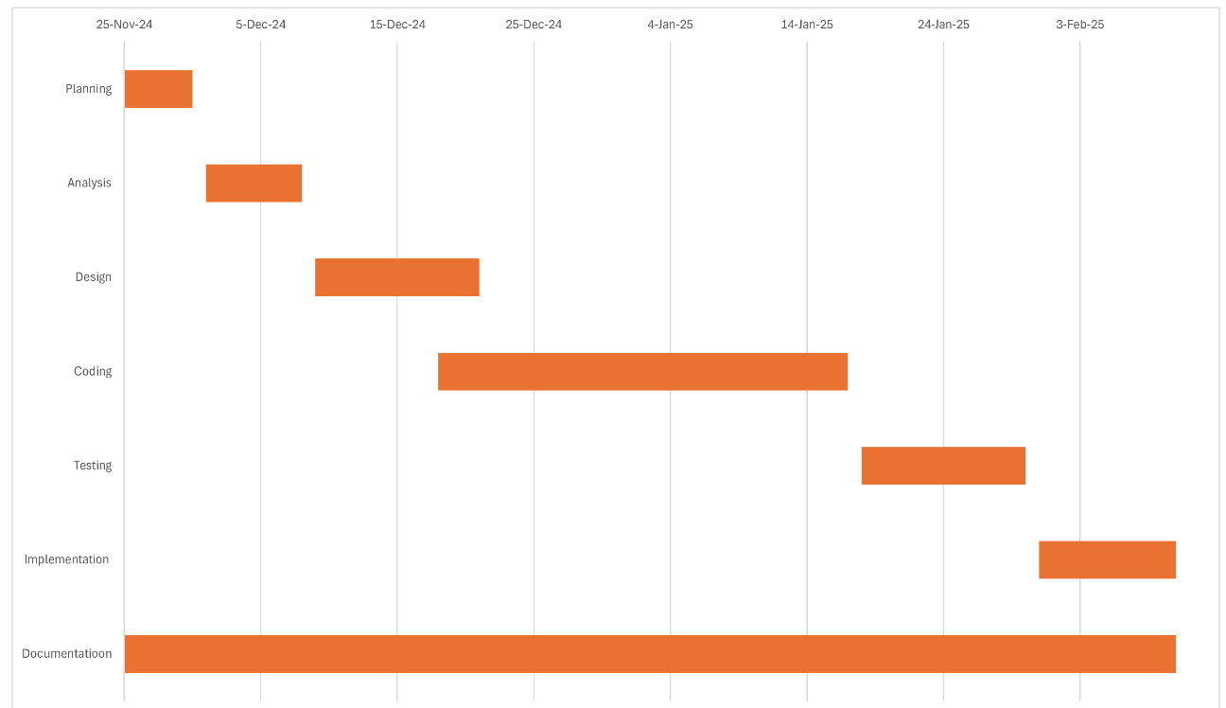
Gantt chart

Slide 32
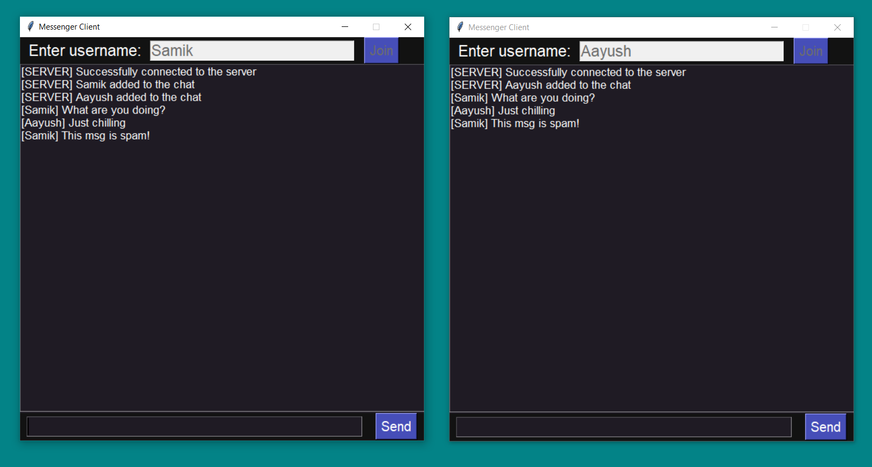
Deployment

Slide 33
Conclusion
We have used Logistic Regression Algorithm with parameters {C: 100, penalty: ’l2’, solver: ’liblinear} to classify the message into spam or ham and implemented this into a chat application which would alert the user when there any spam message.

Slide 34
Scope
Alerts user from spam messages.
Enhance users security.
Provides user with better user experience.

Slide 35
Limitation
Due to limited amount of data, the effectiveness of spam detection algorithm is limited.
Our project in only limited to once language (i.e. English ) so the system cannot detect spam messages in other language.
Spammers constantly evolving their tactics so the algorithm needs more future enhancements.

Slide 36
Future Enhancements
Improving quality of training data.
Support for other languages.
Expand to other domains like audio, images.

Slide 37
Thank You

